Slide 1
Project Ideas

Slide 2
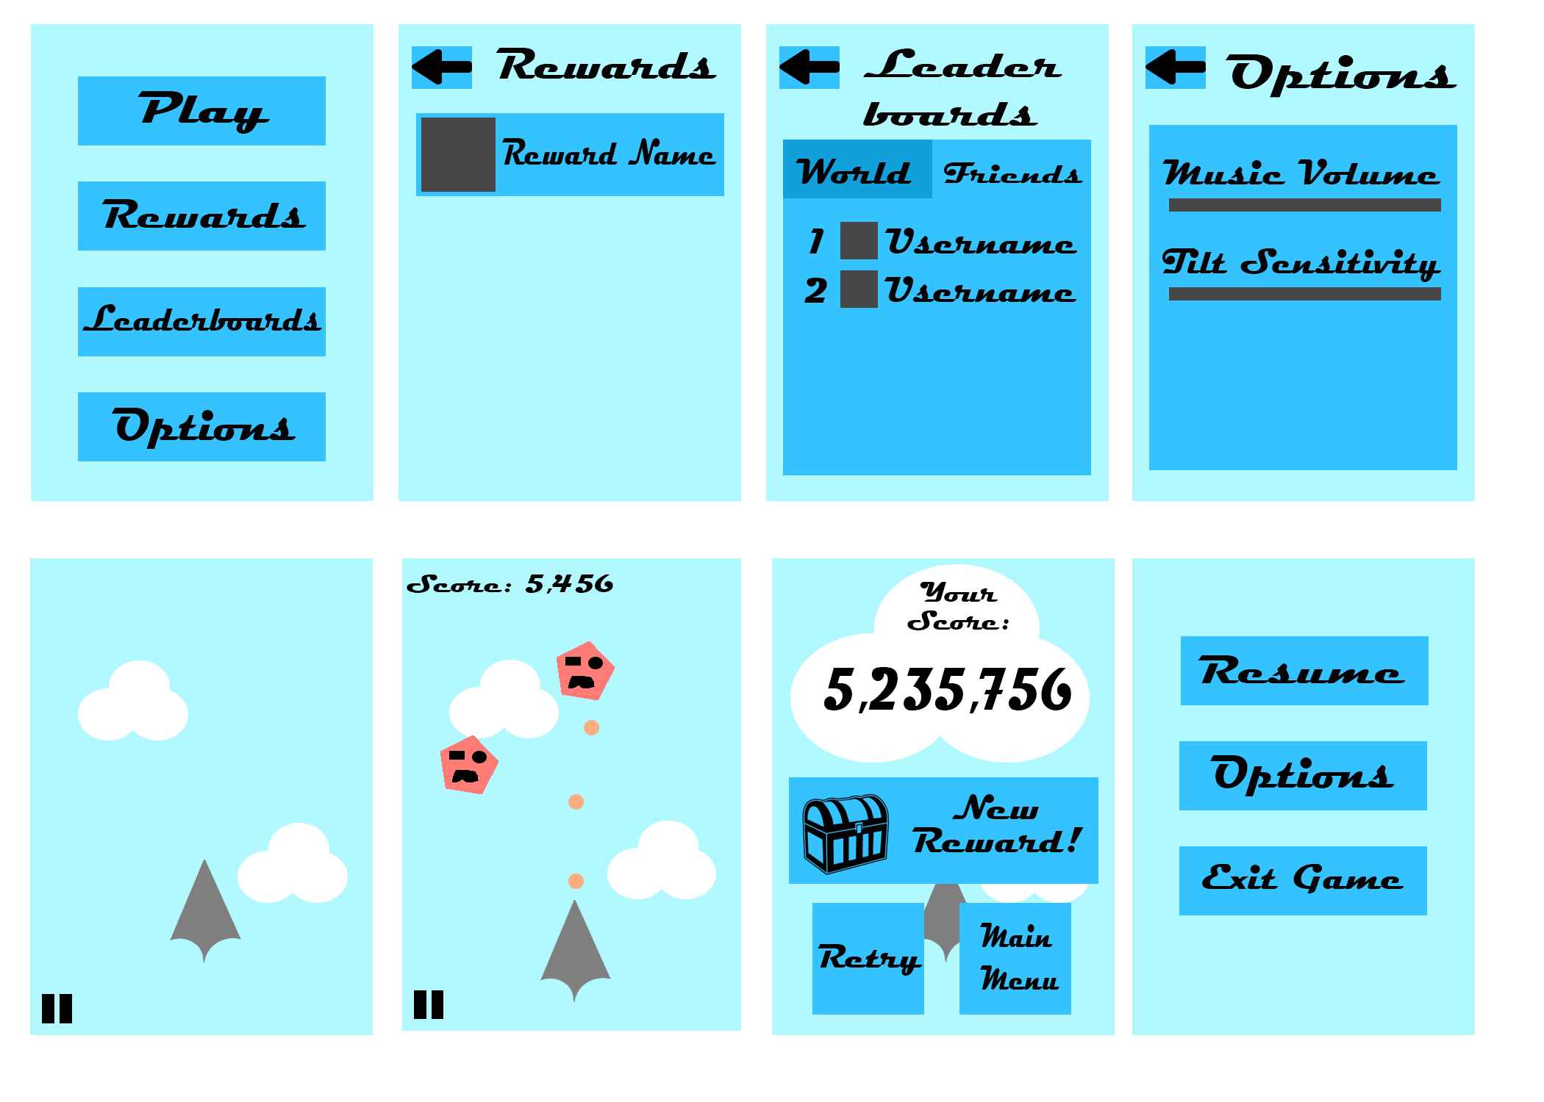
Idea 1

Slide 3

Idea 2
https://www.youtube.com/watch?v=7sl96TciTZ0&list=PL0EC33B912EB629F2&index=11

Slide 4
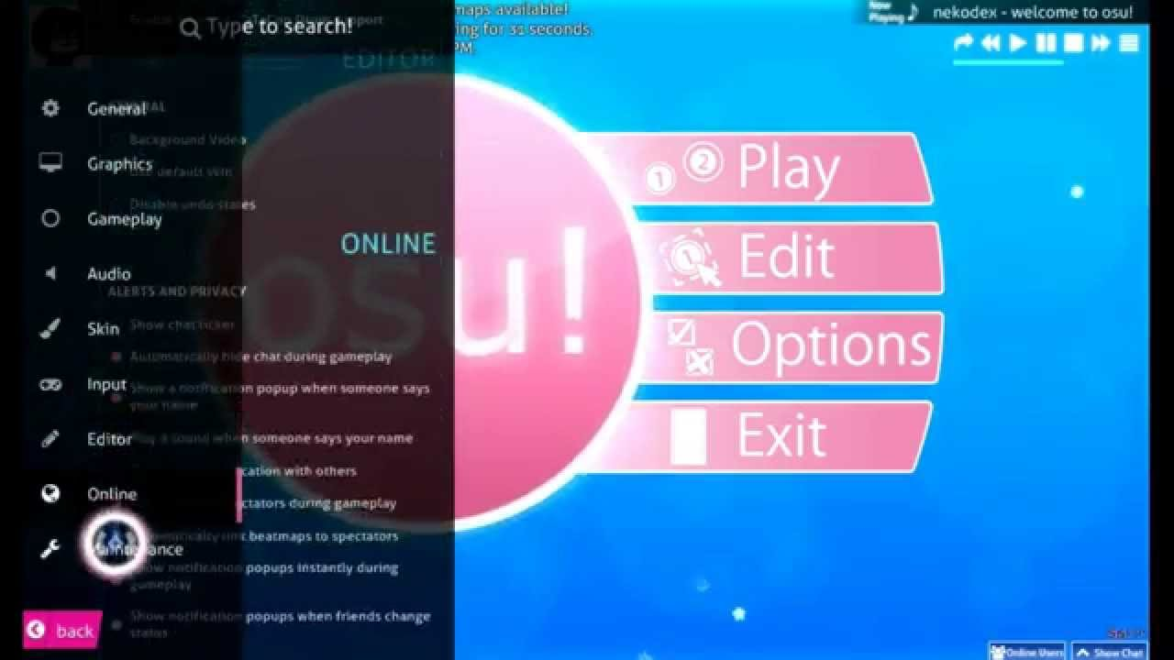

Slide 5


Slide 6

Idea 3
https://www.reddit.com

